Slide 1
PokeCatcher
CSIT-687 Master’s Project
By,
Rishika Devaragatla
Montclair State University

Slide 2
Acknowledgment
I would like to express my gratitude towards my Project Advisor Professor John Jenq for continues support and guidance.
I also want to thank the Graduate committee members Prof. Boxiang Dong and Prof.. Hongbo Zhou for their time and effort.

Slide 3
Table of contents
01
Introduction
04
Design & Implementation
07
Conclusion
02
About the game
05
Key Features
08
Future Scope
03
06
Levels
09
References
Specifications

Slide 4

Introduction
Programming has become an extremely crucial talent to acquire in the current world, from increasing better career chances to developing technical and social abilities.
Career opportunities in the field of Computer Science has increased when compared to the past years and will increase more in the future.
With all this, it is important to discover strategies to inspire beginners/children to learn to code. The traditional teaching techniques would not be appropriate and engaging.

Slide 5
Need for Innovative Teaching Techniques
New teaching techniques are required to meet the evolving needs of learners in digital age.
They have grown up in a world saturated in technology and accustomed to interactive and digital experiences.
Traditional learning techniques that solely rely on textbooks are not effective to capture their attention.

Slide 6
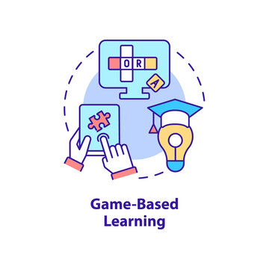
Game-based Learning
Game-based learning refers to use of games and gaming principles in an educational context to enhance the learning experience. It combines elements of both education and entertainment to engage learners and facilitate the acquisition of knowledge and skills.

Slide 7
Effectiveness of Game-based learning in Coding
Game-based learning for Programming concepts involves using games as tools to teach and reinforce programming concepts and skills. This can be applied in the context of programming in following ways:
Concept Reinforcement
Problem-solving skills
Immediate feedback
Gamified Learning Progression
Simulations and Real world application
Practical application of syntax and structure

Slide 8
PokeCatcher

Slide 9
About the game
PokeCatcher is a fun, interactive web-based educational game that teaches programming concepts.
It focuses on concepts which are common in any programming languages.
This games covers topics like:
Variables
Data types
Conditional Statements
Iterative Statements
Procedures
Target Audience
Young learner/beginners
People who want to pursue a career that requires coding skills.

Slide 10
Specifications of the game
Concept
Platform
Users have to drag and drop code blocks sequentially to catch the Pokémon in the poké balls. Each level will introduce a new programming concept, gradually increasing the complexity. Users will learn about variables and datatypes by filling up their basic information.
Multiple platforms including desktops and mobile devices. This implies that players will be able to access this game on their personal computers, smartphones, and tablets, making it more feasible to learn programming concepts on the go.

Slide 11
Specifications of the game
Game Mechanics
User Interface
The game includes interactive challenges and puzzles in which players must arrange code blocks to capture Pokémon’s
User Interface for this game simple and easy, with a code editor that allows drag and drop of code blocks, a grid showing the maze and movement of the pokemon. The interface is tailored for beginners, with simple and succinct instructions as well as visual clues to help players.

Slide 12
Specifications of the game
Graphics
Progress Tracking
The game includes a progress tracking system that allows players to see their progress. This will provide players with a sense of achievement and motivation to capture more Pokémon’s while learning concepts.
The game is designed with colorful and engaging graphics, with a focus on Pokémon characters. The graphics are visually appealing and impressive, making it more enjoyable for players.

Slide 13
Design
& Implementation

Slide 14
Technical Aspects
JavaScript
HTML
css
JavaScript takes care of all the interactions in this game.
EventListerners is a key feature of the language that allows the creation of interactive web-based games.
HTML is used to structure the website for this game.
The canvas tag helps to draw graphics, it is a container that when combined with JavaScript will draw the graphics on the website.
CSS manages the style of the website. The colors, fonts, layouts of CSS make the game visually appealing and colorful
Data Storage: To store the data browser's local storage supported by JavaScript web pages is used. It stores data in a key-pair format. “localStorage” stores the players name, score, game progress

Slide 15
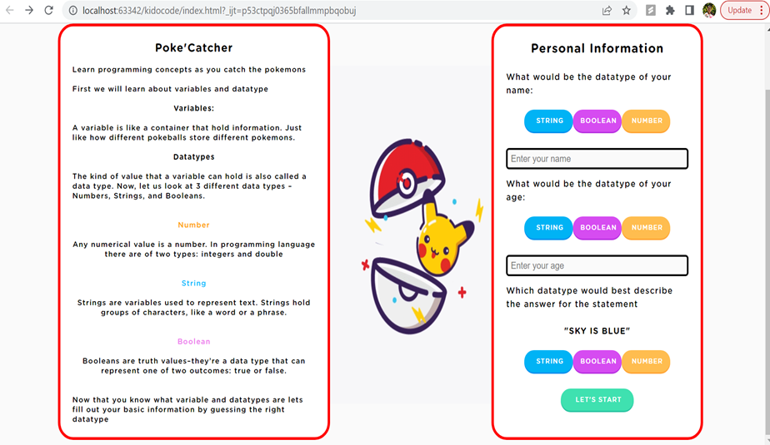
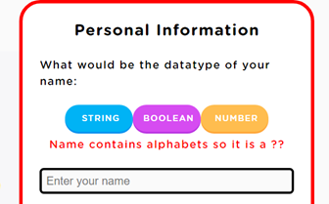
Key Features
Login Page
The login page collects the basic information of the users. But before that, the user has to learn about datatypes and variables and implement them to fill in their basic information.

Slide 16
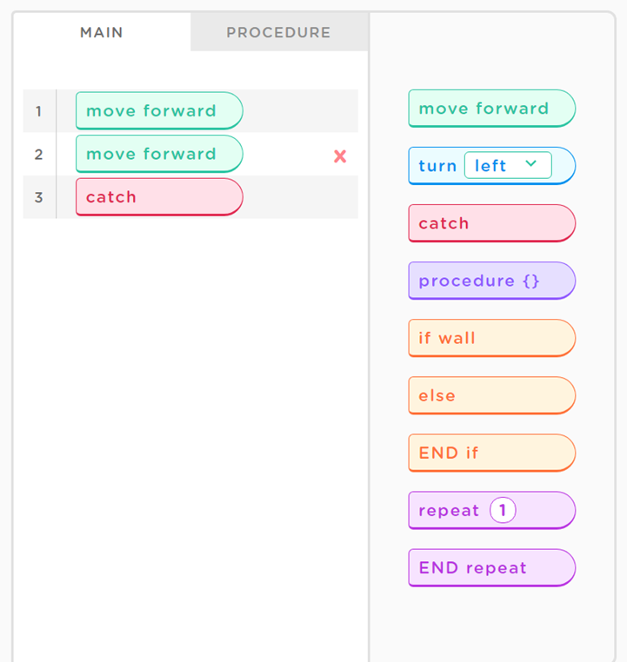
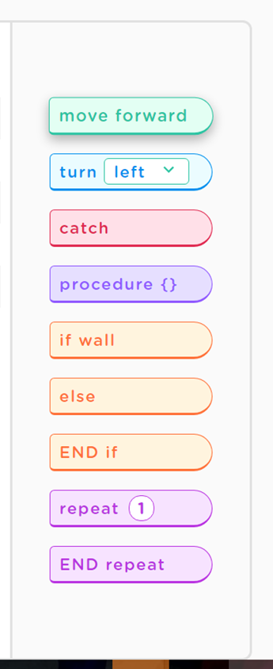
Key Features
Code Editor & Code Blocks
The code editor will be the main interface for the players to arrange the code blocks to catch the Pokémon’s.

Slide 17
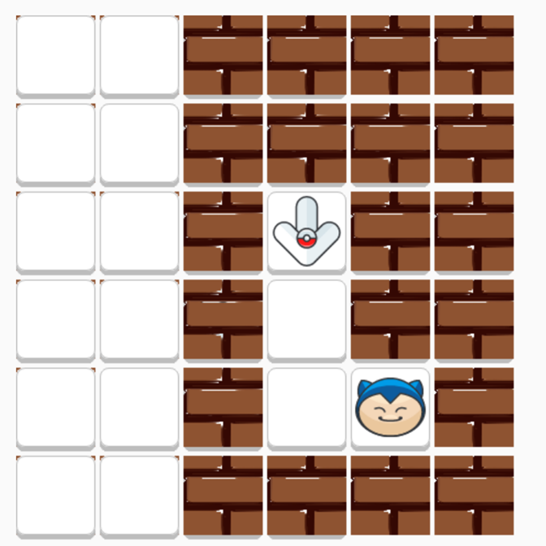
Key Features
Maze-like Environment
The maze-like environment is an important aspect of the game that teaches coding concepts using code blocks. It provides players with a fun and engaging way to explore programming concepts and test skills in a challenging setting.

Slide 18
Key Features
Level Indicator
The level indicator displays the player’s progress through the game.

Slide 19





Levels
Level 1
Level 2
Level 3
Level 4
Level 5
Introduction to programming concepts(Part 1)
Introduction to programming concepts(Part 2)
Functions (Part 1)
Loops (Part 2)
Loops (Part 1)

Slide 20





Levels
Level 6
Level 7
Level 8
Level 9
Level 10
If statements (Part 1)
Functions combined with if-else
If-else statements combined with Loops (Part 2)
Final Challenge
Functions combined with loops

Slide 21
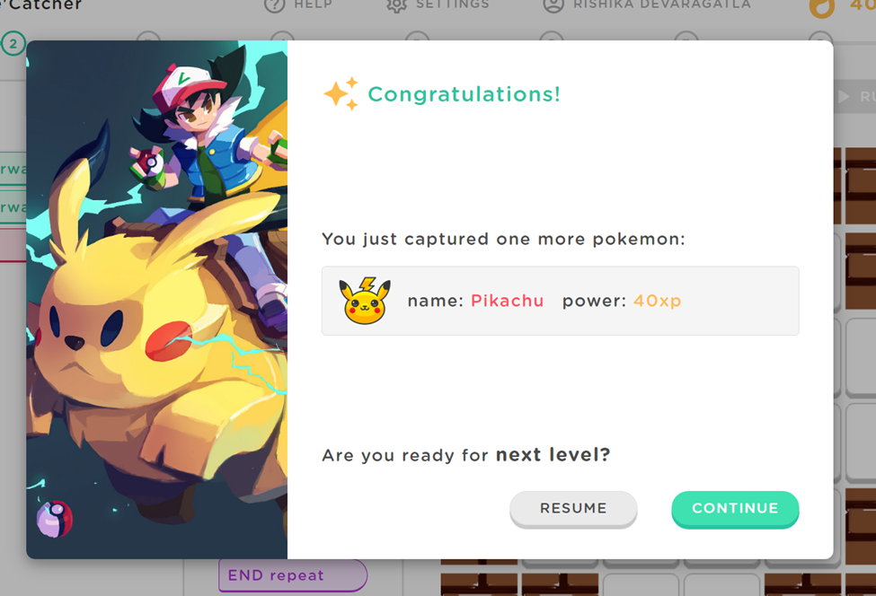
Final Challenge
Incorporates all the programming concepts learned in previous levels to complete a final challenge.
Requires the player to solve a complex problem using combination of if-else statements, loops and functions to complete the game.

Slide 22
Conclusion
An educational game that teaches programming concepts can be a fun and engaging way to introduce beginners to the world of programming.
The game will give an immersive experience that keeps players engaged and ready to learn by employing a maze-like environment and adding components from the famous games such as Pokémon.
The levels are carefully designed and distributed to ensure that each one is built upon the previous level and reinforces the concepts learned.

Slide 23
Future Scope
addition of other programming concepts.
linking this game with other educational games and programs.
combined with other educational settings like in school activities, after school activities

Slide 24
References
French, J. (2022) How to write a game design document (with examples), Game Dev Beginner. Available at: https://gamedevbeginner.com/how-to-write-a-game-design-document-with-examples/ (Accessed: 03 May 2023).
(No date) GTA 00 12 - GameDevs.org. Available at: https://www.gamedevs.org/uploads/grand-theft-auto.pdf (Accessed: 03 May 2023).
Game development (no date) MDN. Available at: https://developer.mozilla.org/en-US/docs/Games (Accessed: 03 May 2023).
Canvas API - web apis: MDN (no date) Web APIs | MDN. Available at: https://developer.mozilla.org/en-US/docs/Web/API/Canvas_API (Accessed: 03 May 2023).
Web apis (no date) MDN. Available at: https://developer.mozilla.org/en-US/docs/Web/API (Accessed: 03 May 2023).

Slide 25
Thank you

